Slide 1
MANAGEMENT CONCEPTS
UNIT -III Lesson - 6 Organising

Slide 2
Organisation definition and nature
An entrepreneur organizes various factors of production like land, labour, capital, machinery, etc. for channelizing them into productive activities.
The product finally reaches consumers through various agencies.
Business activities are divided into various functions, these functions are assigned to different individuals.
Various individual efforts must lead to the achievement of common business goals.

Slide 3
Organization is the structural framework of duties and responsibilities required of personnel in performing various functions with a view to achieve business goals through organization.
Management tries to combine various business activities to accomplish predetermined goals.
Koontz and O’Donnell, ‘The establishment of authority relationships with provision for co-ordination between them, both vertically and horizontally in the enterprise structure.”

Slide 4
Louis Allen, “Organization is the process of identifying and grouping work to be performed, defining and delegating responsibility and authority and establishing relationships for the purpose of enabling people to work most effectively together in accomplishing objectives.”
In the words of Allen, organization is an instrument for achieving organizational goals.
The work of each and every person is defined and authority and responsibility is fixed for accomplishing the same.

Slide 5
1. Nature of an Organisation
A group of people united by a common purpose.
An entity, an ongoing business unit engaged in utilising resources to create a result.
A structure of relationships between various positions in an enterprise.
A process by which employees, facilities and tasks are related to each other, with a view to achieve specific goals.

Slide 6
Organisations as a process (organising)
The process organising involves the following steps
Identifying the work.
Grouping the work.
Establishing relationships.
Delegating authority.
Providing for coordination and control.

Slide 7
Organisation structure
An organizational structure is a system that outlines how certain activities are directed in order to achieve the goals of an organization.
These activities can include rules, roles, and responsibilities.
The organizational structure also determines how information flows between levels within the company.

Slide 8
For example, in a centralized structure, decisions flow from the top down, while in a decentralized structure, decision-making power is distributed among various levels of the organization.
Having an organizational structure in place allows companies to remain efficient and focused.
Businesses of all shapes and sizes use organizational structures heavily.
They define a specific hierarchy within an organization.

Slide 9
A successful organizational structure defines each employee's job and how it fits within the overall system.
Put simply, the organizational structure lays out who does what so the company can meet its objectives.
This structuring provides a company with a visual representation of how it is shaped and how it can best move forward in achieving its goals.
Organizational structures are normally illustrated in some sort of chart or diagram like a pyramid, where the most powerful members of the organization sit at the top, while those with the least amount of power are at the bottom.

Slide 10
1. Principles of Formal Organisation
Accomplishment of objectives.
Efficiency of operation.
Functional similarity.
Balance between authority and responsibility.
Single accountability.
Unity of command.
Functional growth.
Span of control.
Functional balance.
Flexibility.
Stability.

Slide 11
2. Organisational Charts and Manuals
Organisation Chart is the vital tool for providing information about organisational relationships.
Organisation chart is a diagrammatical form, which shows the major functions and their respective relationships, the channels of formal authority and the relative authority of each manager who is incharge of each respective function.

Slide 12
George R. Terry defines an organisation chart as a “diagrammatical form, which shows important aspects of an organisation including the major functions and their respective relationship, the channels of supervision and the relative authority of each employee who is in charge of each respective functions.”

Slide 13
Types of Charts:
1. Vertical chart or Top-down chart.
It represents the level of organisation in the form of a pyramid lines of command proceed from top to bottom.
In this chart highest position is shown at the top level and the lowest position is shown at the bottom level.

Slide 14
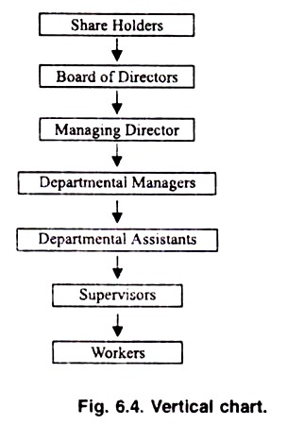

Slide 15
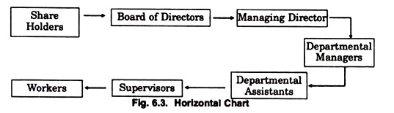
2. Horizontal Chart or left to right chart.
It presents the level of organisation from left to right.
The lines of command proceed horizontally.

Slide 16
3. A Concentric or Circular Chart.
The various positions or functions of an organisation can be shown in circular form.
A concentric or circular chart shows top positions in the centre of concentric circles.
Positions of relative equal importance are located at the same distance from the centre, that is, on the same concentric circle.
Lines joining the different blocks of functions or positions indicate the channels of formal authority.
Its main weakness is that it is often confusing.

Slide 17
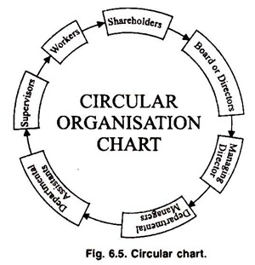

Slide 18
4. Master Chart
The master chart shows the entire formal organisation structure.
5. Departmental Chart
A departmental chart is a supplement to the master chart.
The supplementary charts show details of relationships, authority, and the duties within the prescribed area of a department or major component of the organisation.

Slide 19
Organisational Manual
Organisation chart cannot include all the detail, which is often desirable and necessary for understanding an organisation.
But an organisation manual supplements and provides additional details to the information shown by the organisation chart.
Organisation manual is a small book containing information about the organisational objective, authority and responsibility of various positions and methods and procedures followed.
The manual can be prepared either for the organisation as a whole or parts thereof.

Slide 20
The organisation manual consists the information such as organisational objectives and policies, job descriptions of major positions, organisational procedures, methods and rules.
Thus manual is classified into the following four types of manual:
1. Policy Manual
2. Operation Manual.
3. Organisation Manual.
4. Rules and regulations manual.

Slide 21
Span of control
Span of management, also known as ‘span of control’, refers to the number of people a manager directly manages.
In a wider span of control, a manager has many subordinates who report to him.
In a narrow span of control, a manger has fewer subordinates under him.

Slide 22
In a classical type of organizational structure, which is the most common form, the effectiveness and efficiency of operations is determined by the number of people under direct supervision of a manager.
For most effective operations, it is necessary to have the optimum number of subordinates to supervise.

Slide 23
1. Factors Determining Span of Control or Span of Management
The capacity and ability of the executive.
The capacity and skill of the subordinates.
Nature and importance of the work supervised.
Clarity of plans and responsibility.
Degree of decentralisation.

Slide 24
2. Advantages of Selecting an Appropriate Span of Control
Improved supervision and control.
Superiors can concentrate on important work.
Higher efficiency.
Enhancement in goodwill.
Good professional relations.
Team spirit and morale.
Effective communication and coordination.
Facilities quick action.
Fewer labour absenteeism and turnover.
Advances discipline and mutual trust.

Slide 25
departmentation
Departmentation is the foundation of organisation structure, that is, organisation structure depends upon departmentation.
Departmentation means division of work into smaller units and their re-grouping into bigger units (departments) on the basis of similarity of features.
Louis A. Allen:
“Divisionalisation is a means of dividing the large and monolithic functional organisation into smaller, flexible administrative units”.

Slide 26
As the organisation grows in size, the work is divided into units and sub-units.
Departments are created and activities of similar nature are grouped in one unit.
Each department is headed by a person known as departmental manager.
Departmentation, thus, helps in expanding an organisation and also promotes efficiency by dividing the work on the basis of specialisation of activities and appointing people in various departments on the basis of their specialised knowledge.

Slide 27
In terms of the level of management at which departmentation may be divided into the following three stages:
Primary departmentation: Initial break-up of functions into basic activities.
Intermediate departmentation: Creating departments in the middle levels of the organisation.
Ultimate departmentation: Dividing activities into separate units at the lower levels.

Slide 28
1. Bottom-Up and Top-Down Approaches
The top-down approach relies on higher authority figures to determine larger goals that will filter down to the tasks of lower level employees.
In comparison, the bottom-up style of communication features a decision-making process that gives the entire staff a voice in company goals.

Slide 29
2. Patterns of Departmentation
Departmentation by Functions.
Departmentation by Products or Services.
Departmentation by Project Team.
Departmentation by Territory / Area / Location.
Departmentation by Customers.

Slide 30
Thank you

